Slide 1
Lecture 9
Bitcoin as a platform

Slide 2
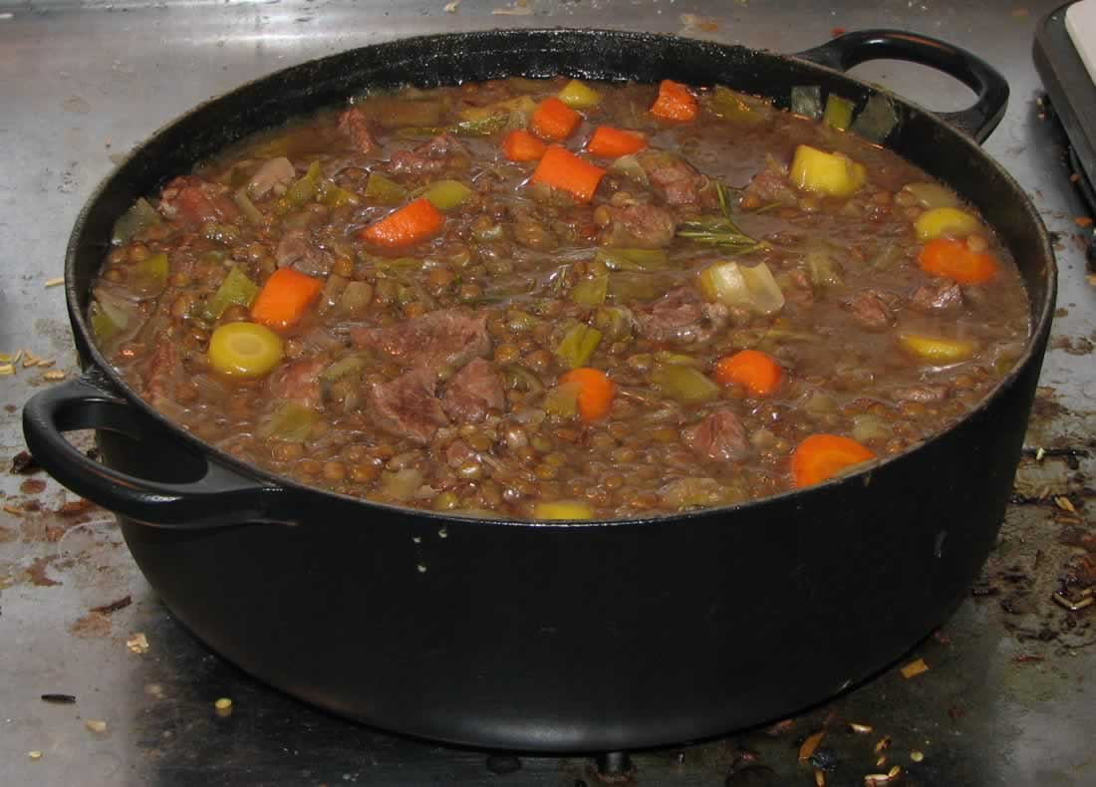
In this lecture
We’ve built Bitcoin. What can we build on top?
Commitments
Token tracking
Multiparty lotteries
Public randomness
Prediction markets
A fine stew o’ ideas

Slide 3
Lecture 9.1:
Bitcoin as an append-only log

Slide 4
Secure timestamping
Goal: Prove knowledge of x at time t
If desired, without revealing x at time t
Evidence should be permanent

Slide 5
Hash commitments
Recall: Publishing H(x) is a commitment to x
Can’t find an x’≠x later s.t. H(x’) = H(x)
H(x) reveal no information* about x
*assuming the space of possible x is big
Can publish a commitment to x, reveal later

Slide 6
Secure timestamping applications
Proof of knowledge
Proof of receipt
Hash-based signature schemes
many, many more...

Slide 7
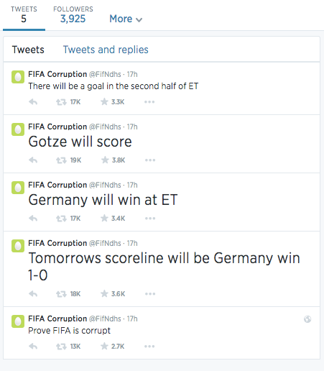
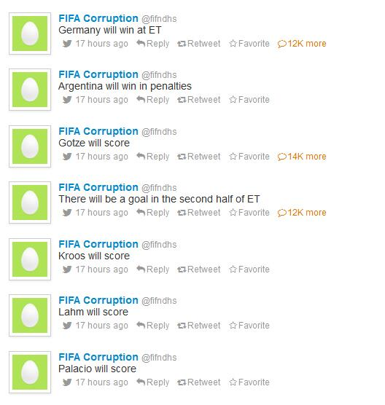
Non-application: proof of clairvoyance
Proof that FIFA is corrupt??
Proving clairvoyance requires proving you didn’t timestamp multiple predictions

Slide 8
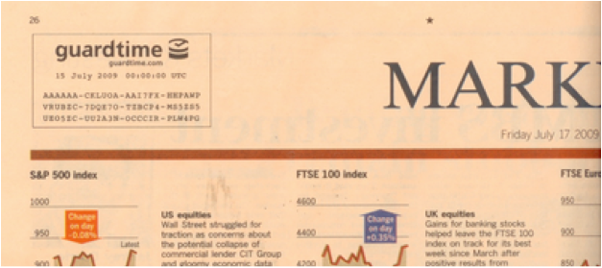
Offline solution: newspaper timestamp

Slide 9
Timestamping in Bitcoin
Idea: Specify the hash of your data instead of a valid public key
Send 1 satoshi to the address
Pros: compatible, easy
Cons: creates unspendable UTXO forever

Slide 10
Timestamping in Bitcoin: CommitCoin
Clark, Essex 2012
Idea: Brute-force a public key & signature starting with the first n bits of your data hash
Pros: compatible, “invisible”, no UTXO bloat
Cons: more expensive, low data rate

Slide 11
Provably unspendable commitments
OP_RETURN
<arbitrary data>
Pros: cheap, no UTXO bloat
Cons: not a standard transaction

Slide 12
Data rates
40-byte commitments for 1 TX fee
0.0001 BTC (currently ≈ US$0.05)
Enough to commit to the hash of whatever you want!

Slide 13
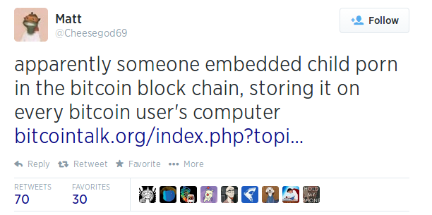
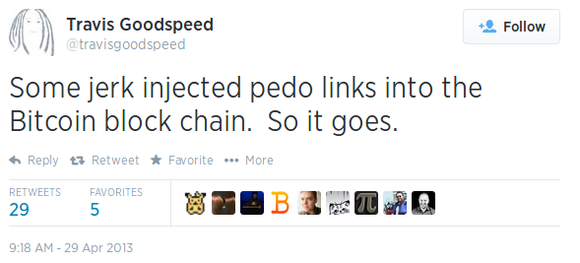
Block chain poisoning
☹

Slide 14
Can we prevent poisoning?
In general, no ☹
Pay-to-script-hash makes it more expensive

Slide 15
Overlay currencies
Observation: timestamping is all we need!
Write all data to the Bitcoin block chain
No new mining/consensus required
Invalid transactions may now be included
Need new rules-first valid tx wins

Slide 16

Mastercoin
Goals: overlay currency with richer transaction set
Smart property, smart contracts
User-defined currency
Pros: more features, faster development
Cons: reliant on Bitcoin, can be inefficient

Slide 17
Lecture 9.2:
Bitcoins as “smart property”

Slide 18
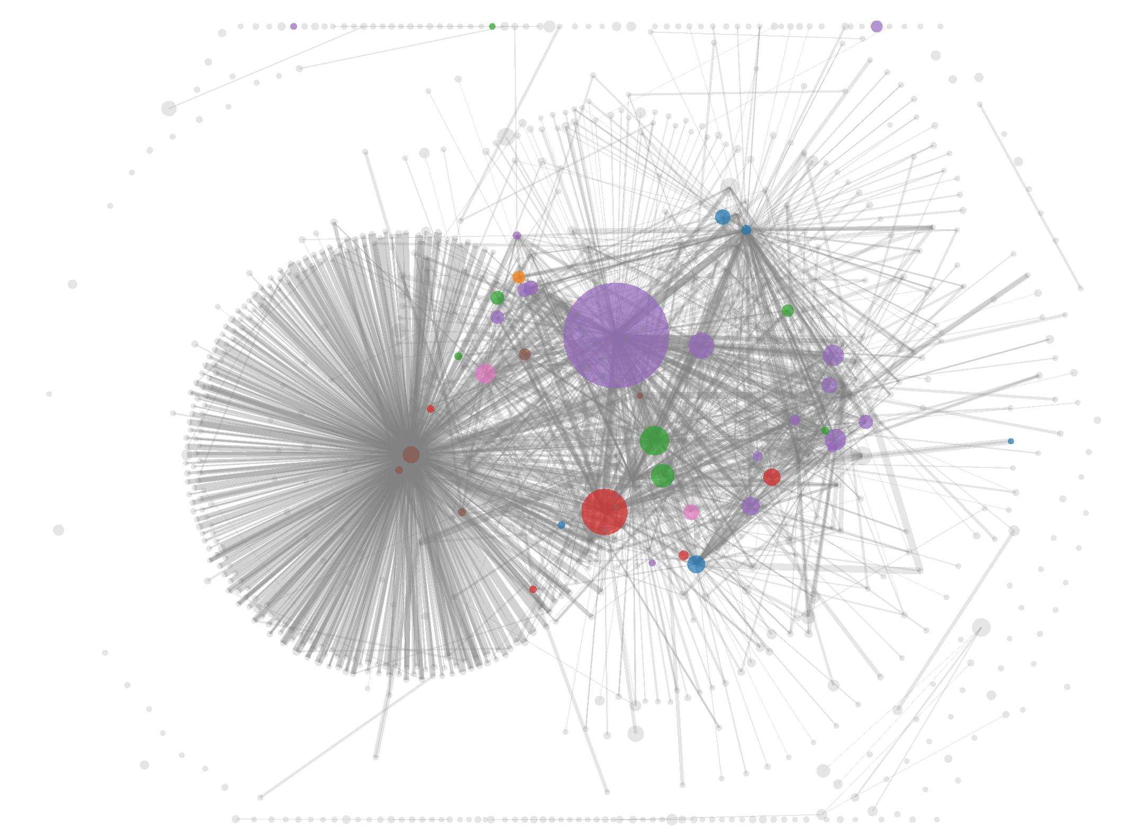
Recall: the transaction graph

Slide 19


Every bitcoin* carries a history
Coinbase
Coinbase
Bad for anonymity
Enables blacklisting
Observation: bitcoins aren’t fungible! Every one is unique
Can this property be useful?
*There are no “bitcoins”, just unspent tx outputs

Slide 20
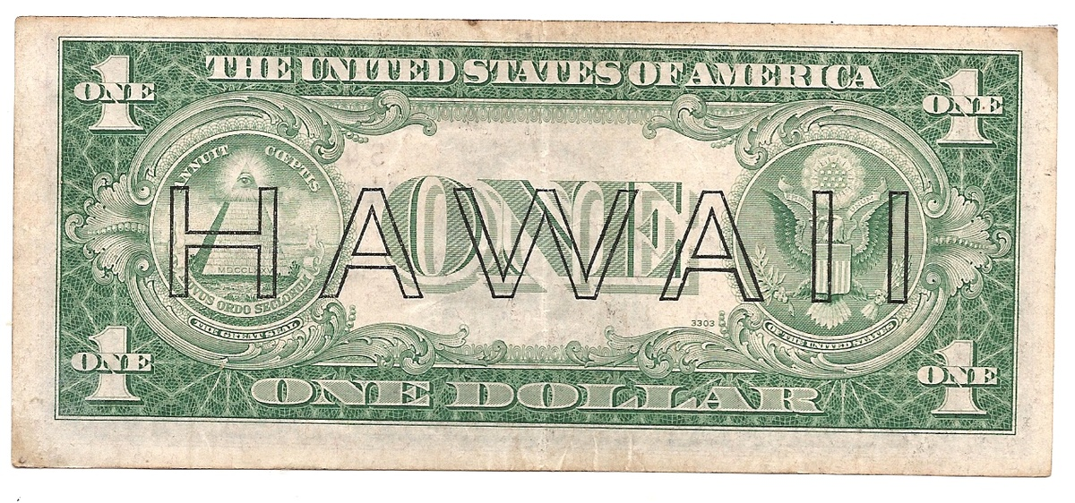
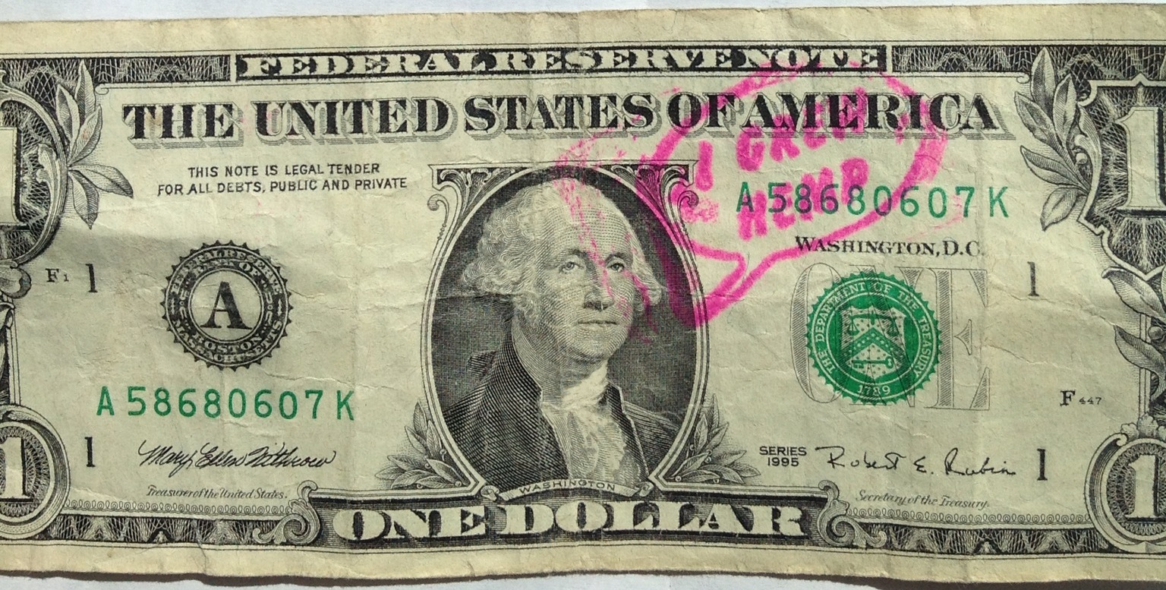
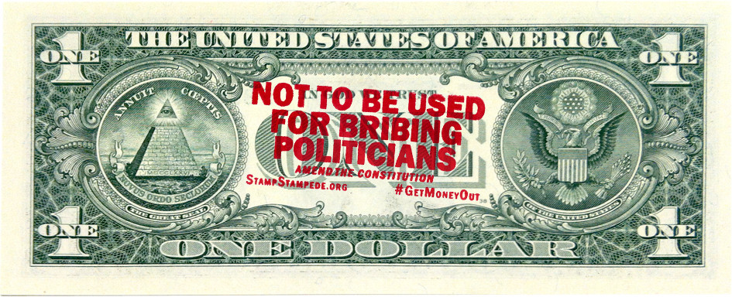
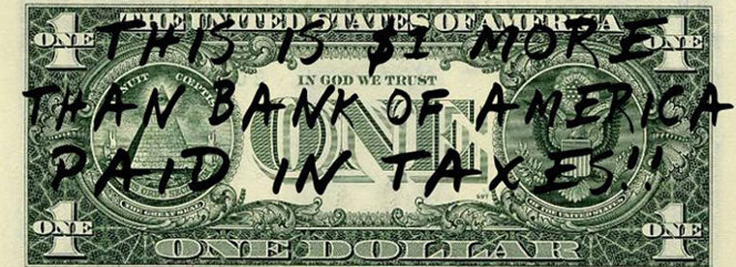
Adding metadata to currency
Without limitations on issuance, just a novelty

Slide 21
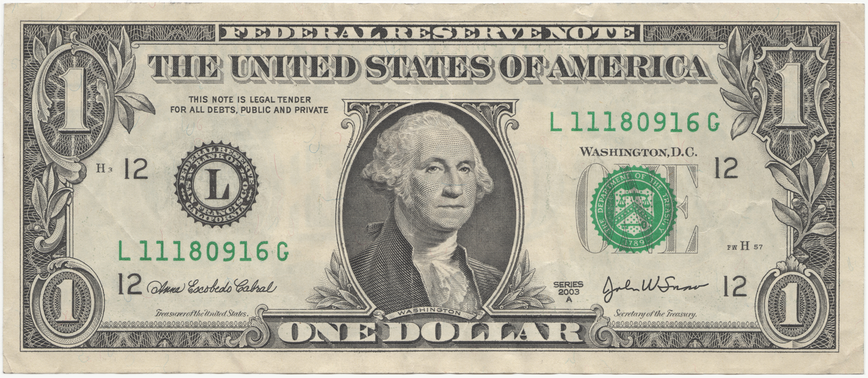
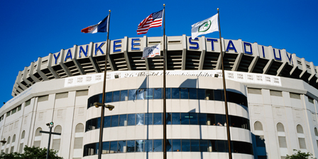
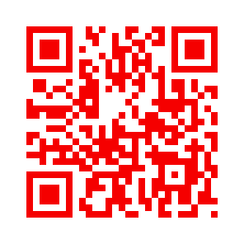
Authenticated metadata for currency
Idea: sign desired metadata + banknote serial #
“Bill #L11180916G hereby grants the holder admission to the Yankees game on Aug 18, 2014”
SIGN_{K}(M, #)
Stadium

Slide 22
Authenticated metadata for currency
Currency can now
represent anything!
Anti-counterfeiting
properties are inherited
Underlying value also maintained!
New meaning relies on trust in the issuer
Some users may not understand new metadata
Can we build this on top of Bitcoin?

Slide 23


Colored coins
12
ISSUE 4
ISSUE 5
4
9
5
7
4
5
9
ISSUE 9
3
1
9
5
13

Slide 24
Implementation: OpenAssets protocol
Coins issued by passing through P2SH address
Issuer declares address with an exchange
Special unspendable “marker” output inserted
Match colored inputs to outputs
Can add extra metadata

Slide 25
Colored Coins
Pros
compatible with Bitcoin
flexible to represent any asset
ignored by community
Cons
small cost of unspendable markers
must check every previous tranasction

Slide 26
Applications
stock certificates
tickets
deeds to real-world property
houses?
cars?
ownership of domain names
NameCoin... stay tuned for our lecture on Altcoins!

Slide 27
Lecture 9.3:
Secure multi-party lotteries in Bitcoin

Slide 28


Real-world lotteries without trust*
*The outcome is fair, but both parties have to trust the other will actually pay up
Sure, I’ll take heads!
Wanna bet $5
Alice
Bob

Slide 29
Online lotteries without trust?
But I can’t see your coin!
I’ll bet $5 on heads!
Network
Alice
Bob
Problem: Alice and Bob want to bet on a coin flip remotely

Slide 30
Hash commitments
Recall: Publishing H(x) is a commitment to x
Can’t find an x’≠x later s.t. H(x’) = H(x)
H(x) reveal no information* about x
*assuming the space of possible x is big

Slide 31

A lottery with hash commitments
Round 1
Round 2
time
Choose random x
Alice
Publish H(x)
Publish x
Hash function guarantees nobody can win with probability more than 1/3
w= H(x⊕y⊕z) % 3
switch (w){
case 0:
winner = Alice;
case 1:
winner = Bob;
case 2:
winner = Carol;
}
Choose random y
Bob
Publish H(y)
Publish y
Choose random z
Carol
Publish H(z)
Publish z

Slide 32
Failure to reveal commitment
Round 1
Round 2
time
Sorry! I, uhh, forgot z
Not cool Carol ☹
Choose random x
Alice
Publish H(x)
Publish x
w= H(x⊕y⊕z) % 3
switch (w){
case 0:
winner = Alice;
case 1:
winner = Bob;
case 2:
winner = Charlie;
}
I’m about to lose...
Sorry! I, uhh, forgot z
Choose random y
Bob
Publish H(y)
Publish y
Choose random z
Ø
Carol
Publish H(z)

Slide 33
Timed hash commitments
Idea: Force x to be revealed by time t
Input: ...; Pay B to EITHER OF:
Alice & Bob, or
Alice & anybody who knows x st. H(x) = c
SIGNED(Alice)
1
MULTISIG
Bond
New script!
Bob can claim the bond at time t
Input: 1; Pay B to Bob:
n_lock_time: t
SIGNED(Alice) SIGNED(Bob)
2
x revealed if Alice reclaims her bond
Input: 1; Pay B to Alice:
SIGNED(Alice), x
3

Slide 34
Lottery with timed commitments
Round 1
Round 2
time
Choose random x
Timed commitment to H(x)
Alice
Publish x
w= H(x⊕y⊕z) % 3
switch (w){
case 0:
winner = Alice;
case 1:
winner = Bob;
case 2:
winner = Carol;
}
I’m about to lose...
Choose random y
Bob
Timed commitment to H(y)
Publish y
But I’ll lose my bond if I don’t publish ☹
Choose random z
Timed commitment to H(z)
Carol

Slide 35
Lottery with timed commitments
Pros:
can be implemented on Bitcoin today
Andrychowicz, Dziembowski, Malinowski, Mazurek 2014
Cons:
complexity is O(N²)
bonds must be higher than amount bet
griefers still might shut down large pools

Slide 36
Lecture 9.4:
Bitcoin as randomness source

Slide 37
Public randomness protocols
Too many interested parties to use hashes?
More convincing randomness to the public?
Designers don’t know alternatives available?

Slide 38
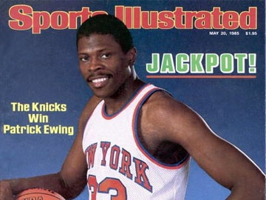
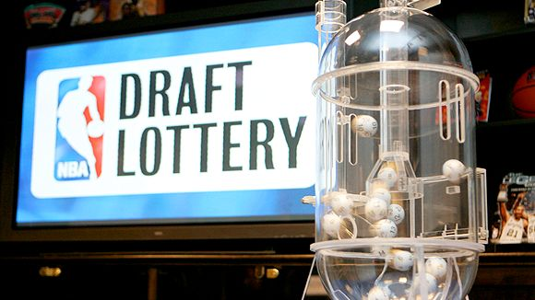
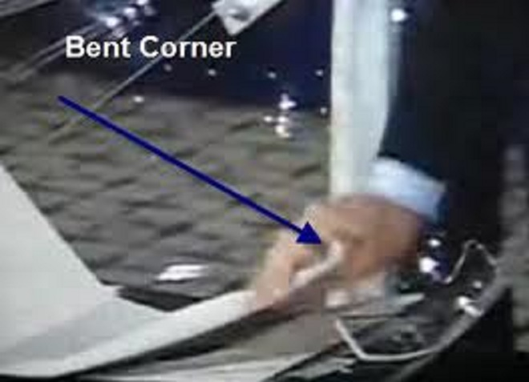
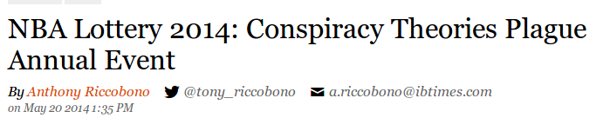
NBA draft lottery
1985: Knicks win rights to Patrick Ewing

Slide 39
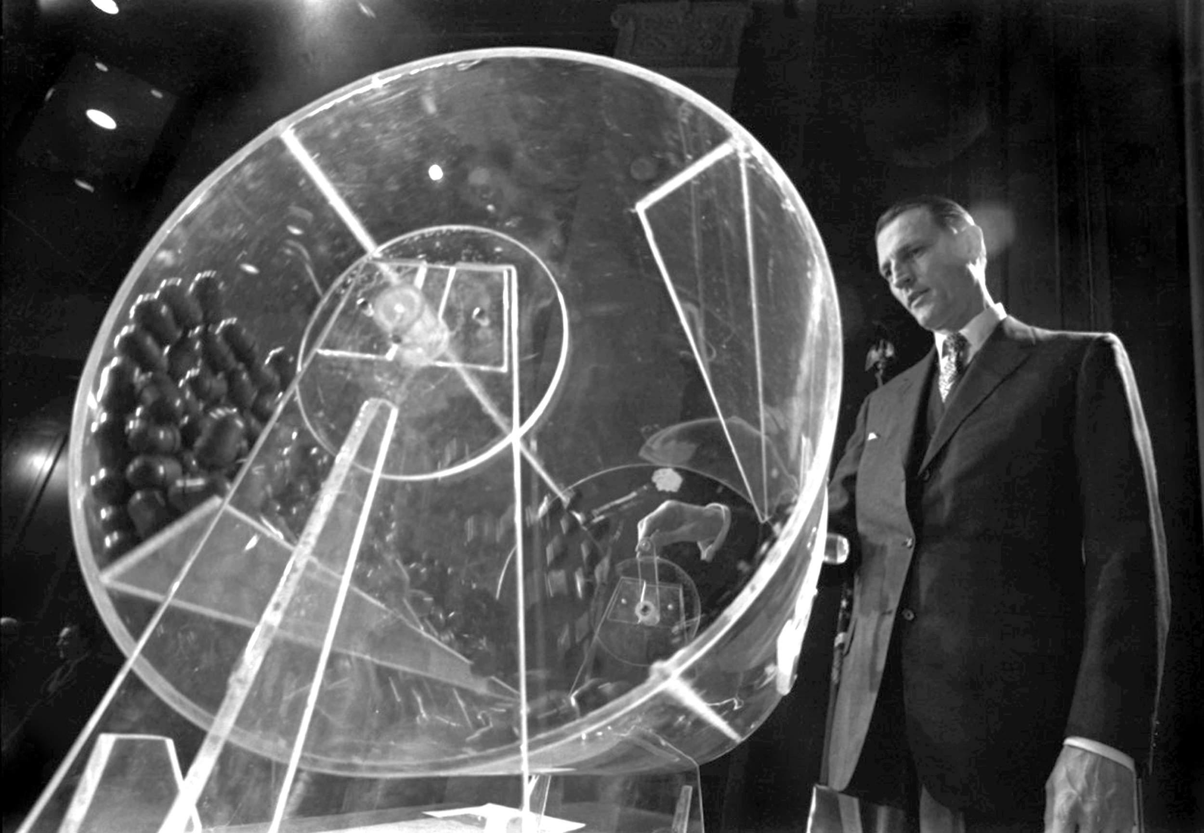
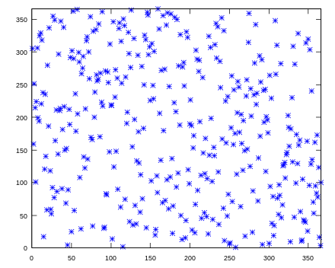
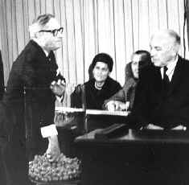
1969 Vietnam conscription lottery
Late-year birthday bias

Slide 40

Cryptographic beacons
Idea: service to regularly publish random data
Uniform randomness
No party can predict in advance
All parties see the same values
01010001 01101011 10101000 11110000 10010100
Applications: lotteries, auditing, zero-knowledge proofs, cut-and-choose, ...

Slide 41
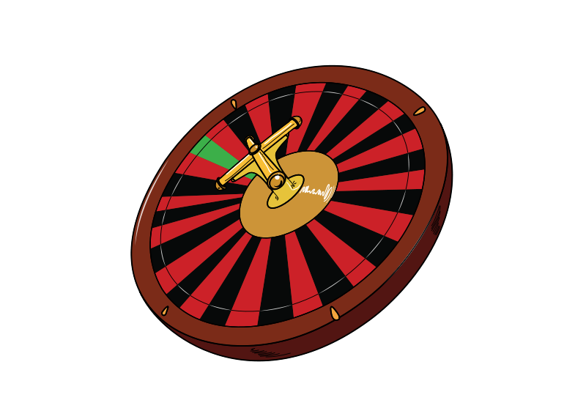
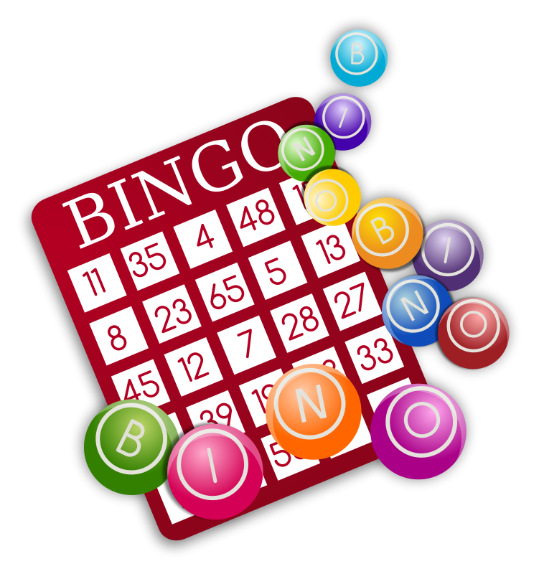

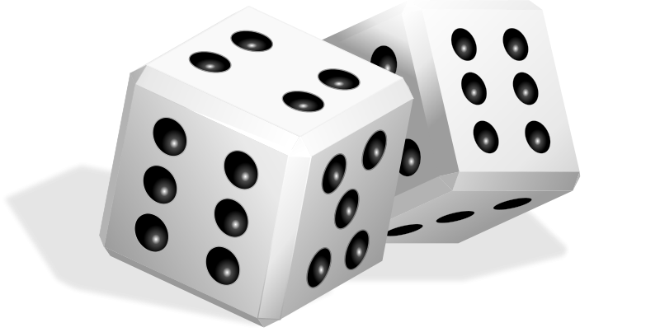
Public display of randomness
Pros: cheap, easy, simple to understand
Cons: must trust/audit operator
hard to trust remotely!

Slide 42
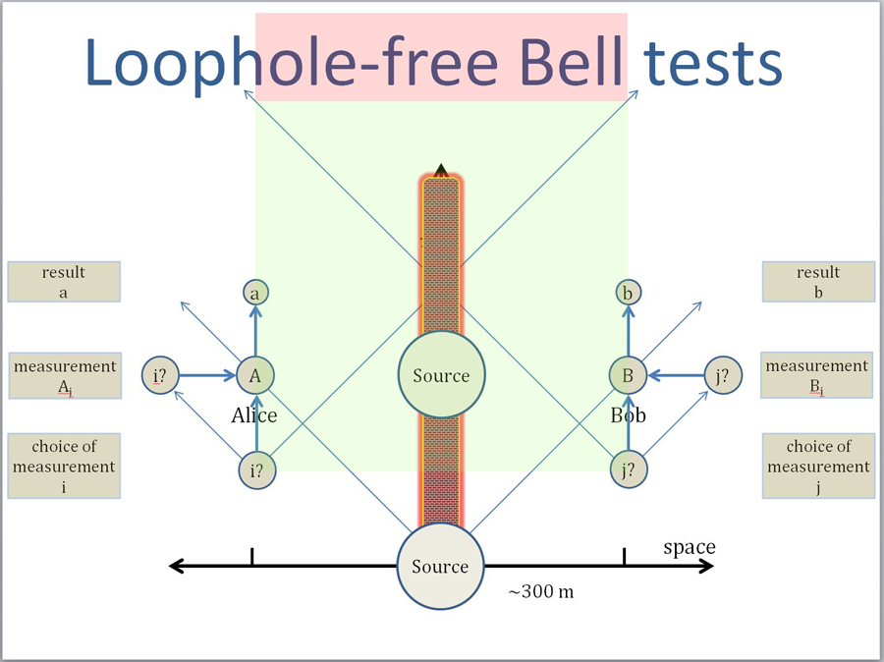
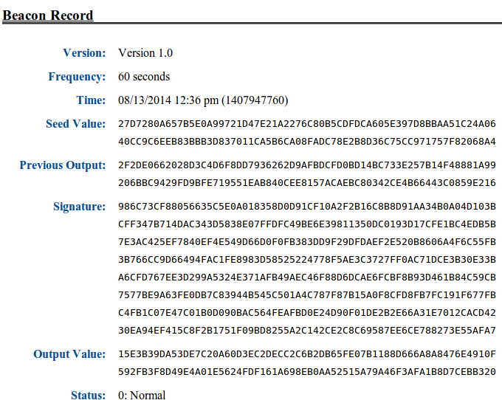
NIST beacon
Pros: quantum-mechanical randomness
Cons: must trust NIST

Slide 43


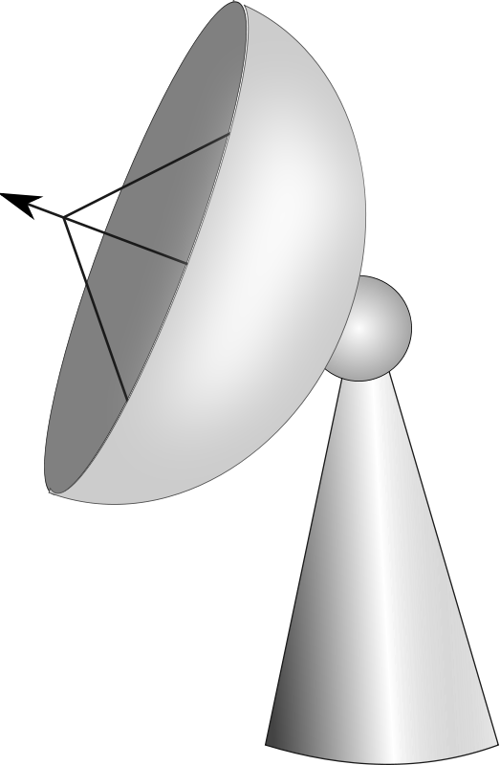
Natural phenomena
Cosmic background radiation
Sun spots
Weather
Pros: publicly observable, random
Cons: slow, need a trusted observer?

Slide 44
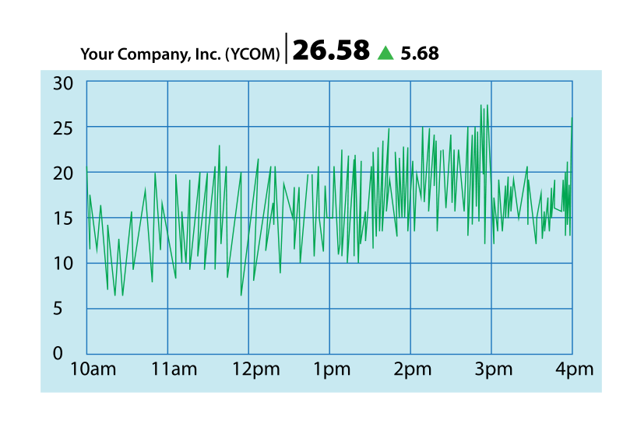
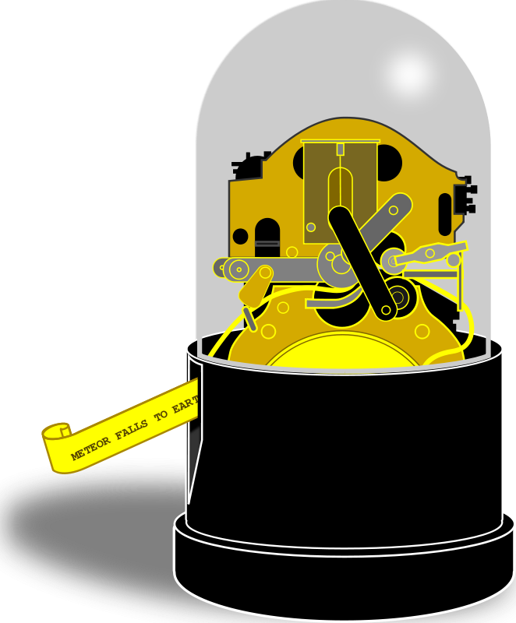
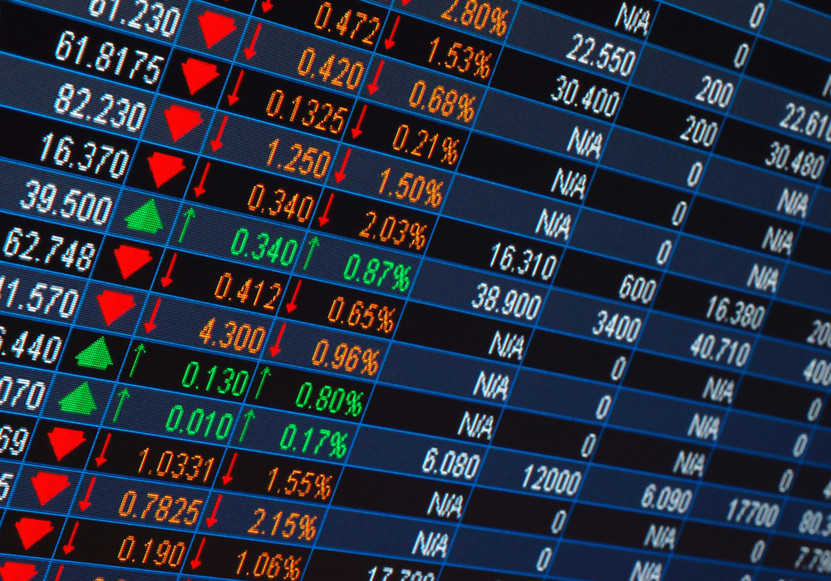
Stock-market beacon
Pros: good randomness, costly to manipulate
Cons: slow, insider attacks?

Slide 45
Why not use the block chain?
Recall: miners find random nonce for each block
If you could predict the next nonce with a greater than 1/d probability, you’d have a mining shortcut
Currently, d > 2⁶⁶

Slide 46
Turning the block chain into a beacon
prev: H( )
prev: H( )
prev: H( )
mrkl_root: H( )
mrkl_root: H( )
mrkl_root: H( )
nonce: 0x0001...
nonce: 0xffff...
nonce: 0x0000...
nonce: 0x0001...
nonce: 0x0002...
nonce: 0xf77e...
nonce: 0x0001...
nonce: 0xffff...
nonce: 0x0000...
nonce: 0x0001...
nonce: 0x0002...
nonce: 0x7a83
nonce: 0x0000...
nonce: 0xf77e...
nonce: 0x0000...
hash: 0xd0c7...
hash: 0xd0c7...
hash: 0x6a1f...
hash: 0x300c...
hash:
hash: 0x0224...
hash: 0xc9c8...
hash: 0x0000...
hash: 0x6a1f...
hash: 0x300c...
hash:
hash: 0x0224...
hash: 0xc9c8...
hash: 0x3485...
hash: 0x0000...
hash: 0x0000
hash:
hash: 0x3485...
hash:
Extract
Extract
Extract
01010001 10101000 10010100

Slide 47
Cost of manipulation
Attacker might mine a block but discard it
Or bribe other miners to do so
Bernoulli trials: forcing a beacon outcome with probability p requires discarding 1/p - 1 blocks
Discarding a block “costs” 25 BTC

Slide 48
Cost of manipulation
Single coin flip: secure if wager is < 25 BTC
N-party lottery: secure if pool is < 25 (n-1) BTC

Slide 49
Pros
First proposal for fully decentralized beacon
Output every 10 minutes
Can precisely analyze manipulation costs
Can extend security with multiple blocks
Not very efficient

Slide 50
Cons
Timing is imprecise
Block chain not synchronized w/ real time
Need to delay to insure against forks
Manipulation may be too cheap for some applications

Slide 51
Built-in beacon support in script
Idea: add an opcode for a beacon call
Can build multi-party lotteries
only one round
no bonds
no time delay for refunds

Slide 52
Lecture 9.5:
Prediction markets & real-world data feeds

Slide 53
Assertions about the outside world
Idea: add a mechanism to assert facts
election outcomes
sports results
commodity prices
Bet or hedge results using smart contracts
Forwards, futures, options...
Most general formulation: prediction market

Slide 54
Prediction markets
Idea: trade shares in a potential future event
Shares worth X if the event happens, 0 if not
Current price / x = estimated probability

Slide 55





Example: World Cup 2014
pre-tournament
0.12 0.09 0.22 0.01 0.05
after group stage
0.18 0.15 0.31 0.06 0.00
0.26 0.21 0.45 0.00 0.00
before semis
Can immediately profit!
before finals
0.64 0.36 0.00 0.00 0.00
final
1 0 0 0 0
Should have shorted

Slide 56
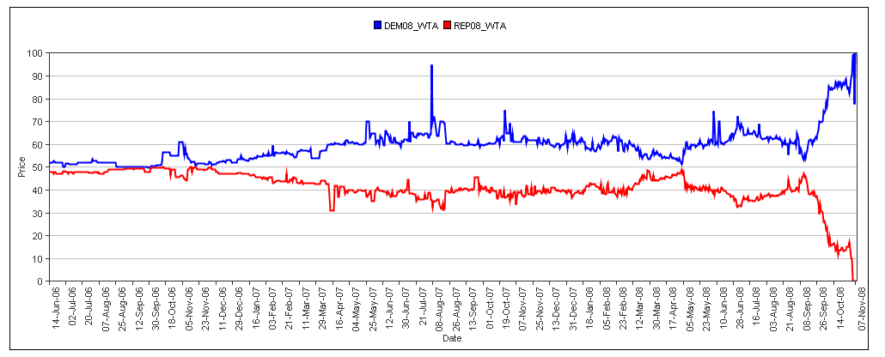
Example: 2008 US Presidential election
source: Iowa Electronic Markets

Slide 57
Prediction markets
Economists love them
reveal all knowledge about the future
(under a number of assumptions)
allows profit from accurate predictions
“a tax on BS”
Often beat polls and expert opinions
Significant regulatory hurdles
InTrade shut down in 2013

Slide 58
Decentralized prediction markets?
Decentralized payment & enforcement
Decentralized arbitration
Decentralized order book

Slide 59
Decentralized payment & settlement
Simple solution: Bitcoin + trusted arbiters
Better solution: altcoin with built-in support

Slide 60
Payment & settlement - FutureCoin
BuyPortfolio(event e)
one share in every outcome for $1
TradeShares(...)
exchange shares for each other or currency
one way of profiting
SellPortfolio(event e)
redeem one share in every outcome for $1
Clark et al. 2014

Slide 61
Arbitration models
Trusted arbiters
allow anybody to define & open a market
risk of incorrect arbitration, absconding
Users vote
requires incentives, bonds, reputation
keynesian beauty contest?
Miners vote
may be disinterested or not know

Slide 62
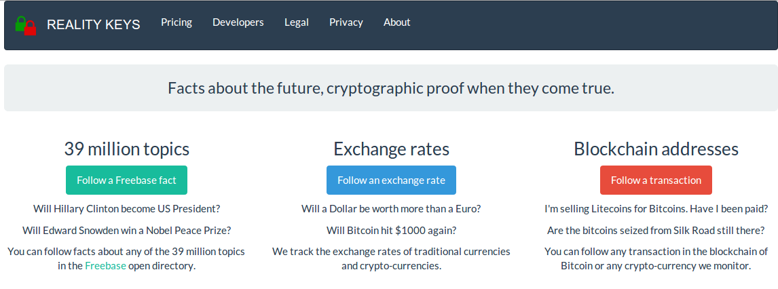
RealityKeys

Slide 63
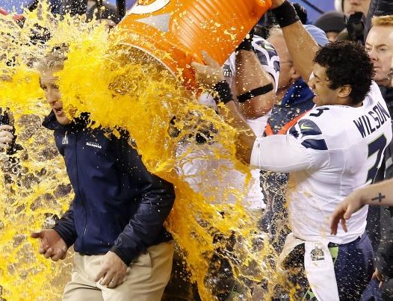
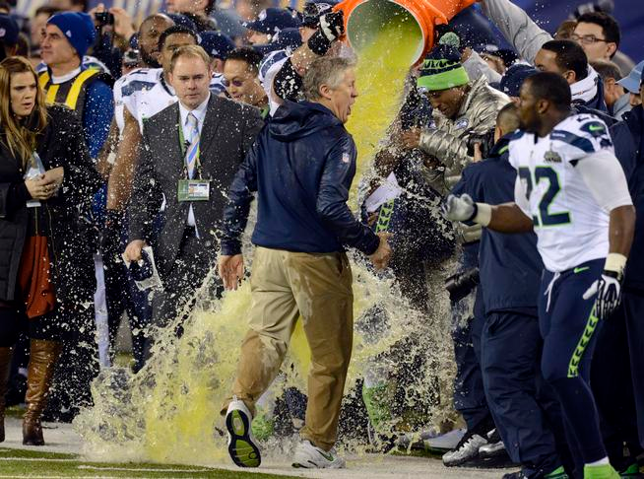
Reality can be complicated!
Super Bowl XLVIII:
what color gatorade will be poured on the winning coach?
Clear:0.31 Orange:0.22 Yellow:0.22 Blue:0.08 Red:0.08 Green:0.08
Orange?
Yellow?
Notes:
These images are copyrighted. This slide can be deleted if needed. This was the best I could do

Slide 64
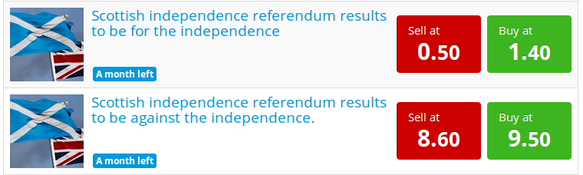
Order books
Goal: match best bid and ask offers
Predictious.com

Slide 65
Centralized order books
Traditional model
Promise to split surplus between buyer, seller
Front-running is considered a serious crime!
require regulation, auditing, monitoring

Slide 66
Decentralized order books
Idea: Submit orders to miners, let them match any possible trade
Spread is retained as a transaction fee
Front-running now not profitable!
May be less efficient
Higher fees
Slower trades to avoid higher fees

Slide 67
Decentralized order books
Idea: Submit orders to miners, let them match any possible trade
Spread is retained as a transaction fee
Front-running now not profitable!
May be less efficient
Higher fees
Slower trades to avoid higher fees

Slide 68
What can be built on Bitcoin?
payment | ✓
settlement | no trades
arbitration | trusted arbiter only
order books | must be external
Bitcoin isn’t enough

Slide 69
In the next lecture

Slide 70
Bitcoin can only take us so far
What if we could start again from scratch?

